Slide 1


CHINA MARKET UPDATE
February 9, 2023

Slide 2

Chris Thompson
President & CEO Brand USA

Slide 3

Virginia Lin
Director, China Travel Trade Brand USA

Slide 4
TABLE OF CONTENTS
❏ China Market Overview
❏ Developments for COVID Policy and International Travel
❏ Key Points of Re-Opening Policy Change
❏ Hurdles
❏ US-China Air Connectivity
❏ Chinese Traveler Sentiment
❏ Opportunities to Rebuild
❏ Brand USA Travel Trade Activities

Slide 5


China Market Overview–Economic Update
To incorporate a faster recovery from the post-Covid exit wave Oxford Economics raised China 2023 full-year GDP growth forecast to 4.5% (from 4.2% previously). Alongside the Q4 2022 GDP beat, China’s high frequency economic data has–for now–ceased to consistently disappoint, with emerging green shoots of recovery.
In the first 11 months of 2022, China-US trade volume reached $681 billion USD, up 4.8% year-on-year.
This year China has put the domestic market at the core of the economic recovery drive,to put more weight on restoring and expanding consumption, while promoting high-level opening-up, and vigorously boosting market confidence.
Annual Growth Rates | 2020 | 2021 | 2022
Gross Domestic Product | 2.3 | 8.1 | 3
Source: Oxford Economics and China General Administration of Customs

Slide 6
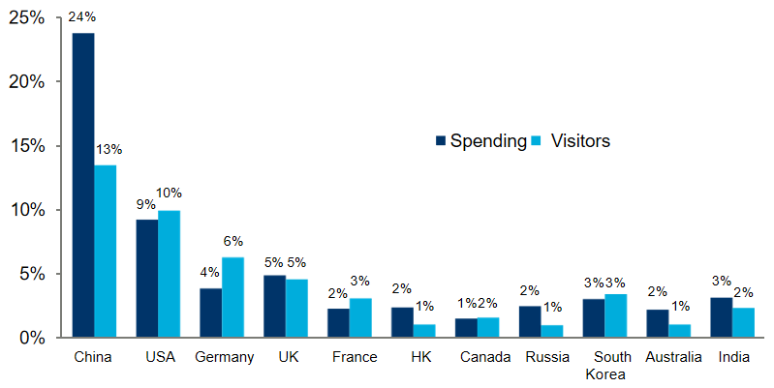


China Made the Largest Contribution to Global Growth 2010-19
Contribution to Growth in Global International Travel: 2010 to 2019
Top ten markets for spending in 2019 plus India
In 2019
155 million Chinese travelled abroad
spending $254.6 billion.
Source: Tourism Economics

Slide 7


Developments for COVID Policy and International Travel
11 November 2022
Circuit breaker flight cancellation
policy scrapped; inbound
quarantine reduced to 5+3,
testing requirements relaxed
6 December 2022
Deputy Director of China’s CDC says Zero COVID cannot continue
On 26 December 2022, Chinese government announced the re-opening from 8 January 2023
26 December 2022
Chinese government announced the re-opening from 8 January 2023
22 September 2022
China’s CDC releases
paper outlining
COVID exit plan
29 November 2022
Beijing News described Covid as a “bad cold”
As of the start of December 2022, 90.28% of China’s population is fully vaccinated
8 January 2023
Border Re-opened
From the end of November 2022, despite rising COVID cases, the country’s COVID policies have seen quick and dramatic changes. On 26 December 2022, the Chinese government announced the end of most international travel restrictions from 8 January 2023.

Slide 8
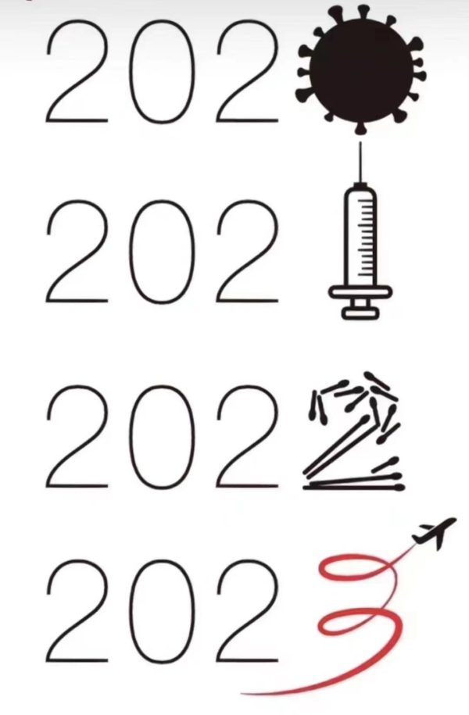

Key Points of the New Policy: After 8th January 2023
Reopen borders and resume outbound leisure travel in an orderly manner
Passports are being issued/renewed as normal
Abolish quarantine and PCR testing upon arrival in China
Remove seat capacity limits on international flights
No digital travel pass
Downgrade severity of COVID virus, prohibiting local governments from imposing quarantines
What’s required?
48-hour PCR test and health declaration for customs.

Slide 9

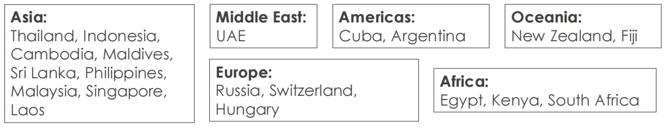
Outbound Group Travel is Now Allowed
On 20 January 2023, the Ministry of Culture and Tourism announced a pilot scheme to resume outbound group and package travel from China. The sale of these travel products had been banned since late January 2020.
From 6 February 2023, outbound group and package travel is allowed for travel to below 20 countries. Travel agents can release and launch packaged tour products and promotions starting on the same day.

Slide 10
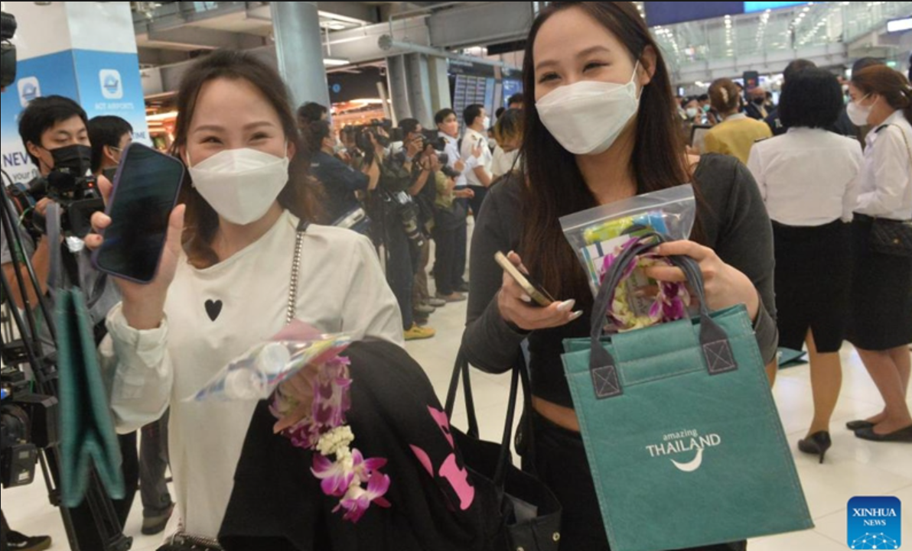
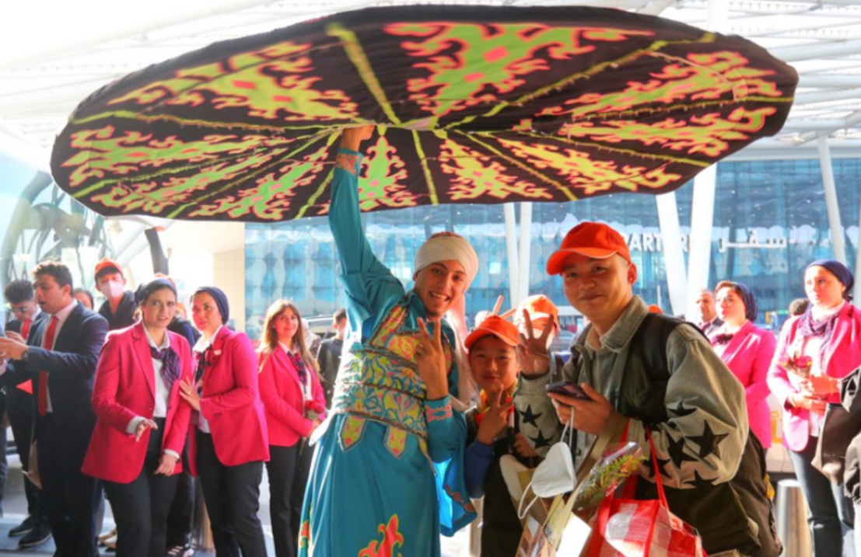
China’s Reopening to Inject Over $200b to Global Tourism
Thailand on Feb. 6 welcomed the arrival of thousands of Chinese tourists in its capital of Bangkok, the first group following China's optimization of COVID-19 strategy which took effect on Jan. 8
An Egyptian artist performs a traditional folk dance to welcome Chinese tourists at the Cairo International Airport in Cairo, Egypt on Feb 6.
Source: Global Times

Slide 11
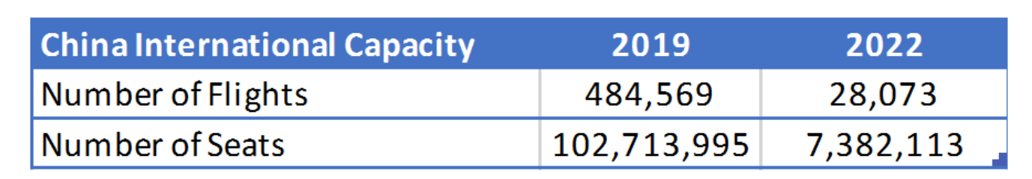
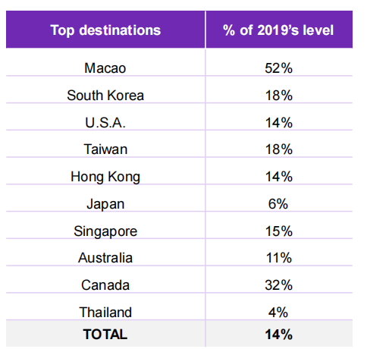

Hurdles
Low availability of flights and relatively high cost of air travel
Passport application/renewal backlog
Ongoing restrictive policies in organizing group travel
Time required for the industry to build up service capacity
Booked international departures from China between Jan and Mar 2023, as of 7 Jan 2023; vs 2019 levels
International Capacity To China 2019 vs 2022
US flight booking reached 14% of 2019’s level
International flights out of China are at just 8% of pre-pandemic levels in 2022.
Source: OAG Schedules Analyser

Slide 12
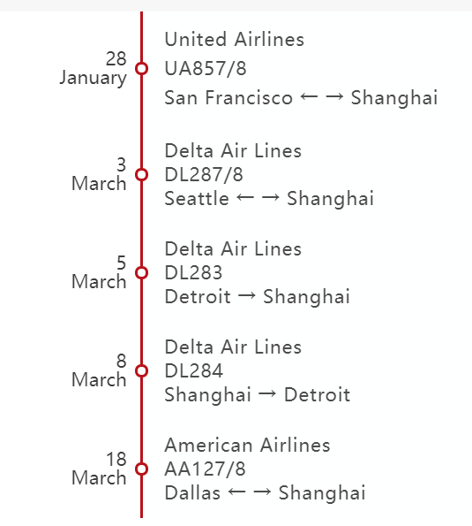

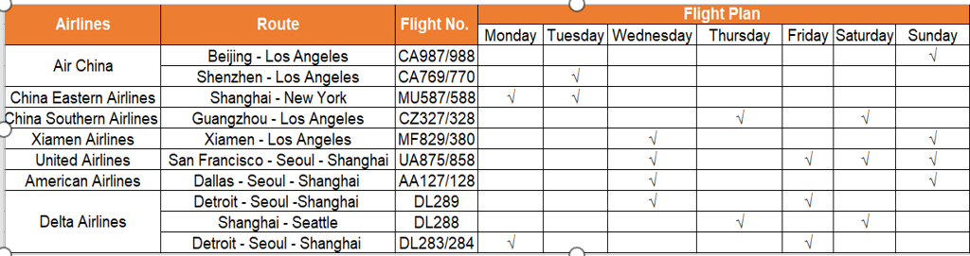
U.S.-China Air Connectivity
United Airlines, American Airlines, Delta Air Lines will resume nonstop flights between the US and China, no longer have a stopover in Seoul.
Air China, Xiamen Airlines, Sichuan Airlines and Hainan Airlines plan to expand their schedules between the USA and China
United Airlines will resume nonstop flights between Hong Kong and San Francisco beginning on March 6.
There are only 18 flights to U.S. cities from China per week and will increase to 24 flights by March.

Slide 13




New Flight Application
Beijing – LAX daily between Jan.18 – Mar. 25
Beijing – SFO 4 flights per week between Mar. 1 - Mar. 25
Beijing – NYC daily between Jan.18 – Mar. 25
Chengdu – LAX 1 flight a week between Feb. 19 – Mar. 25
Beijing - Boston 2 flights per week between Feb. 17 to Mar.25
Beijing - Seattle 2 flights per week between Feb. 17 to Mar. 25
Xiamen – LAX 2 flights per week between Jan.18 – Mar. 25

Slide 14
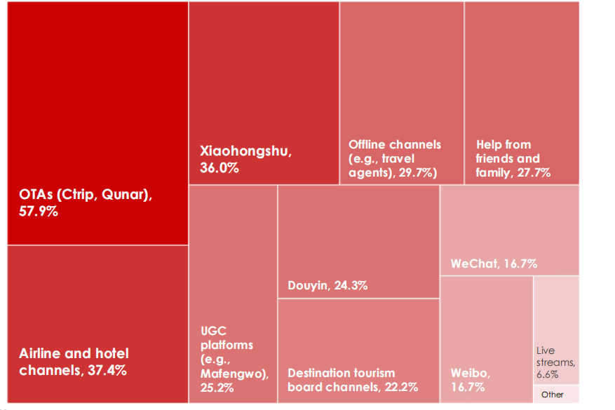




Chinese Traveler Sentiment
Chinese travelers are ready to go
Top demands for travel products are pricing, safety, and convenience
Family travel will dominate
OTAs stand out for travel planning, but don’t underestimate social media
Source: Chinese traveler survey December 2022 January 2023 (Dragon Trail)

Slide 15

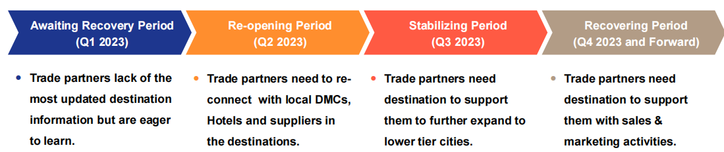

Opportunities to Rebuild
Travel Agents Need Destination’s Support More Than Ever
"Reconnect China"- Offline Trade Shows are Back
Product Development
Be Ready for Business Travellers

Slide 16
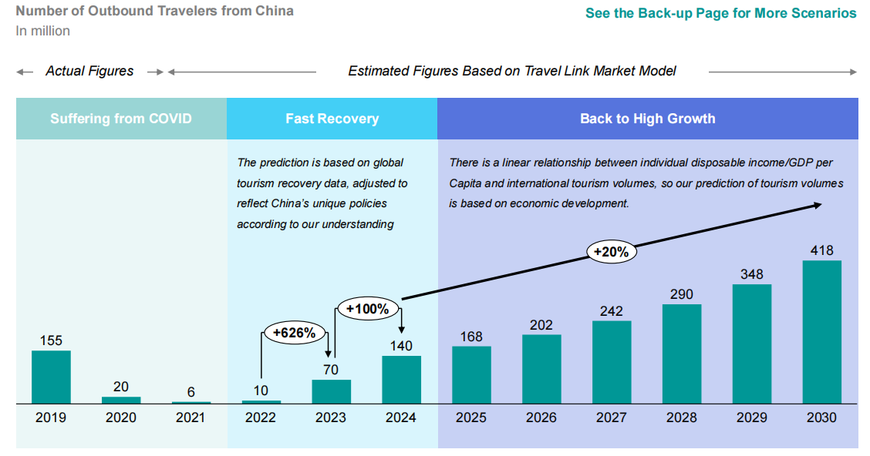
China market will likely recover from 2023 and remain one of the market with the highest growth in the world from 2024 onwards
2023 Recovery Prediction: 45%
2024 Recovery Prediction: 90%
Source: Travel Link Analysis

Slide 17

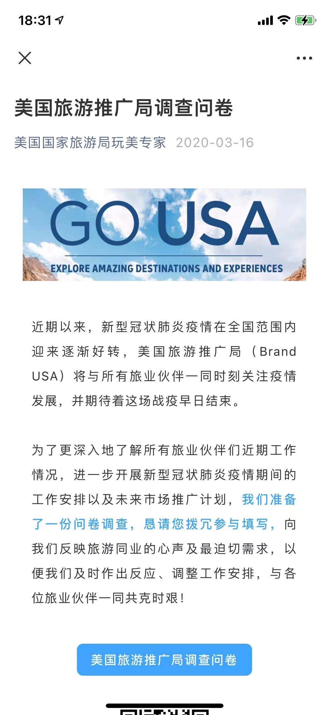
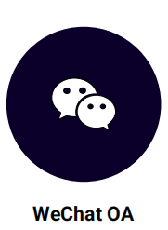

Travel Trade Activities-Brand USA B2B Program
Brand USA WeChat Official Account
5,148 followers (+130 comparing to FY21)
16,577 views (+6,594 comparing to FY21)
18,664 engagements (+7,764 comparing to FY21)
(Very low attrition rate even the boarder is not yet re-open)
USA Discovery Mini Program
4,868 Registered Users in FY22 vs 4,470 in FY21
1,443 Participating companies
54,620 Badges earned by users (+1,212 comparing to FY21)
39 USA Discovery Experts

Slide 18


Travel Trade Activities-Agent Webinars
Brand USA China has successfully hosted webinars partnered with DMOs and airlines and U.S. Commercial Service. Total webinar participants is at 540.
US Destination Webinar for China Travel Group

Slide 19

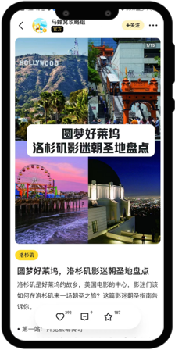
Travel Trade Activities-Marketing Campaign
Brand USA partnered with VC launched a direct-to-consumer campaign in November 2022 and runs through March this year. The campaign shares a “See You Soon” message deployed over the newly updated Visit California hub on Ctrip, featuring gateway cities of San Francisco and Los Angeles, along with California content and branding with Mafengwo, China’s top FIT travel guide.

Slide 20



Brand USA Award
Tuniu. com presented Brand USA “2021 Destination Training Outstanding Contribution” Award
Won “Best Strategic Foresight of the Year” by Ctrip.com

Slide 21

Thank You

Slide 22

Nancy Lyu
Regional Sales Manager, China
United Airlines

Slide 23

Edison Chen
General Manager of Destination Marketing and Strategic Alliances Trip.com Group

Slide 24
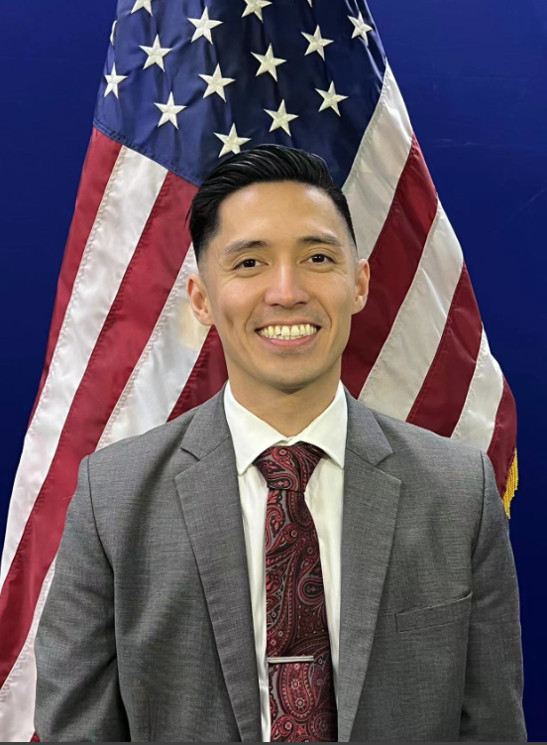
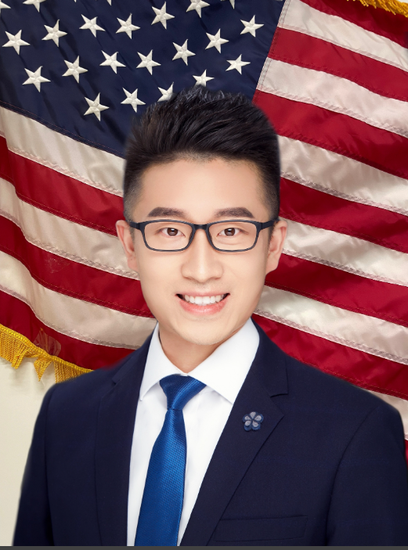
Godfrey Angara
Jiawei Wang
Commercial Officer
Commercial Specialist

