Slide 1

The Multicultural Multiplier
Cultural Diversity’s Impact on International Traveler’s Intent
August 23, 2022

Slide 2
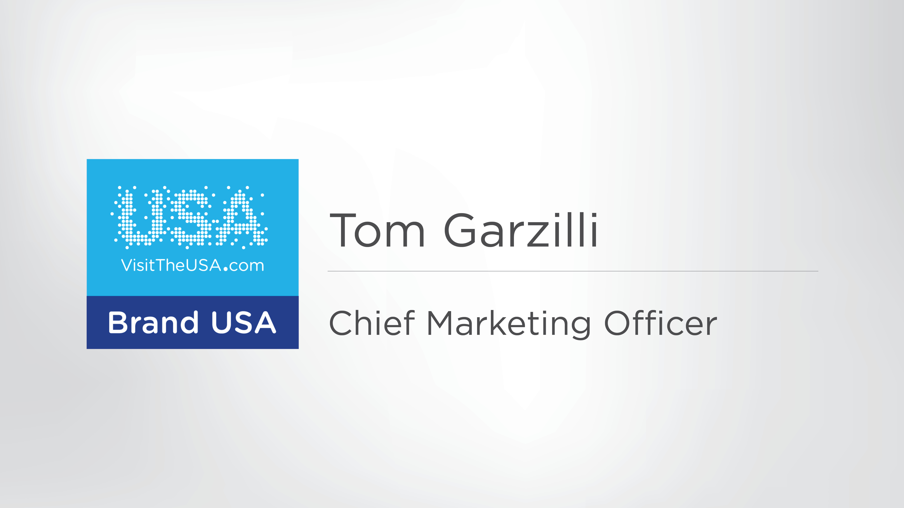

Slide 3
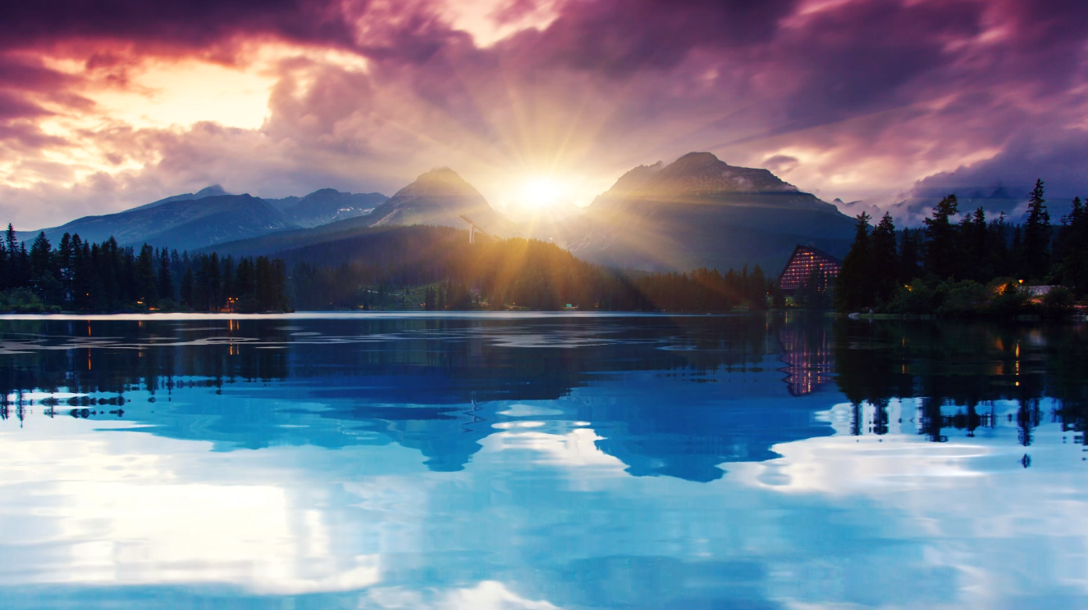


STRATEGY RESEARCH IMPACT
Bridging data to action

Slide 4
Kübler-Ross Emotional Response to Change
Morale And Competence
Shock
Surprise
or shock at the event
Denial
Disbelief: Looking for evidence that it isn’t true
Frustration
Recognition that things are different:
feeling like a victim
Anger/Depression
Low mood: lacking in energy and/or focusing on blame
Experiment
Initial engagement with new situation; considering new ways of doing things
Decision
Coming to terms; feeling more in control and more positive
Integration
Changes understood and accepted:
a renewed sense of normal
Time
©2022, iolite group llc. All rights reserved.

Slide 5



Slide 6

Consumption Dreams

Slide 7

Economic Realities

Slide 8


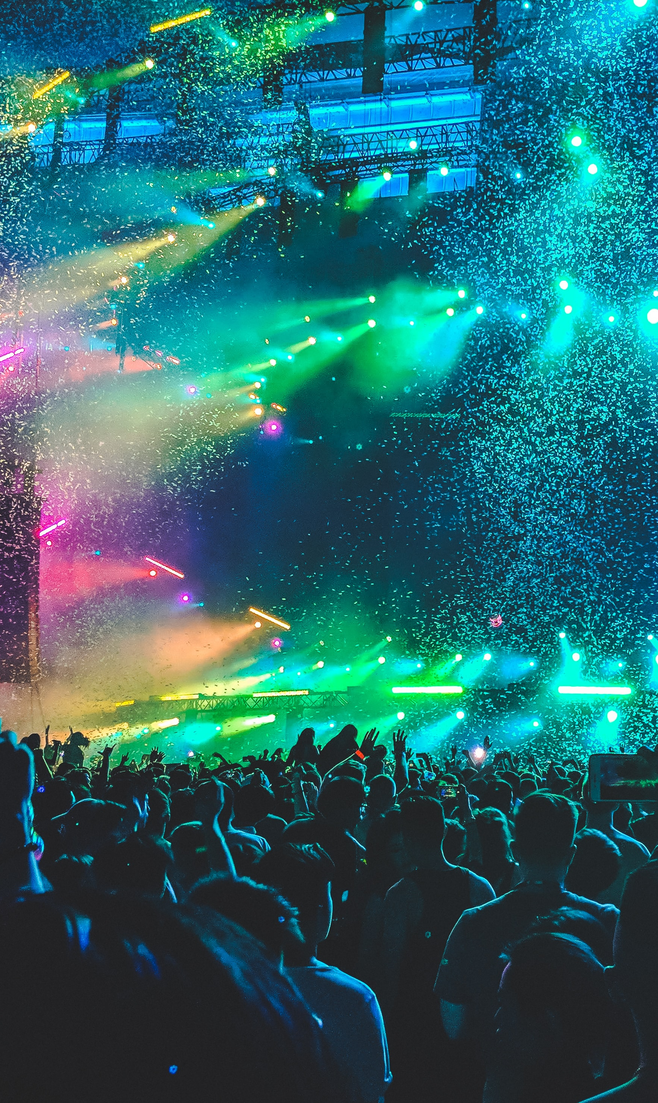
Return to normalcy
De-stress
Live it up

Slide 9

Workation

Slide 10
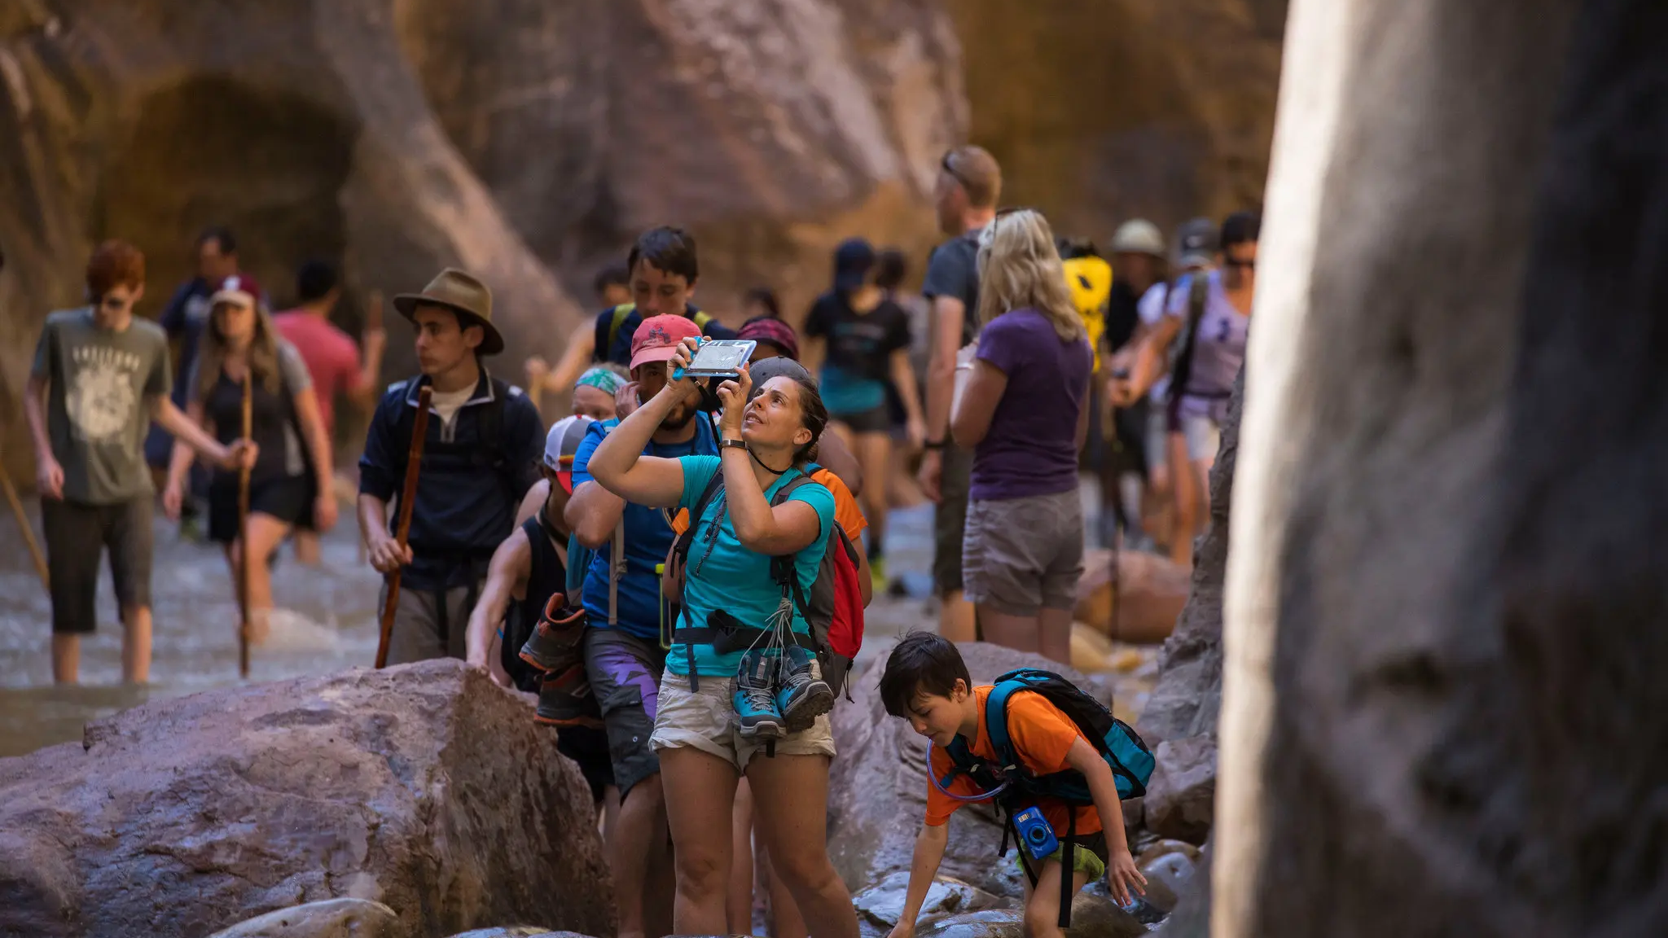

Slide 11


Slide 12

Our greatest challenge has reversed

Slide 13
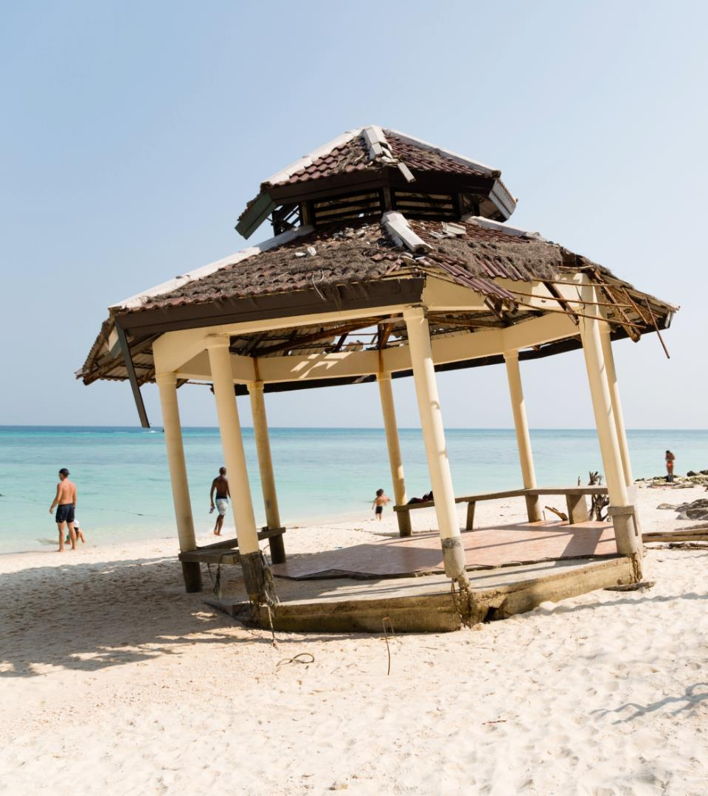

Overtourism, climate change and inequality are now critical business issues

Slide 14



Slide 15
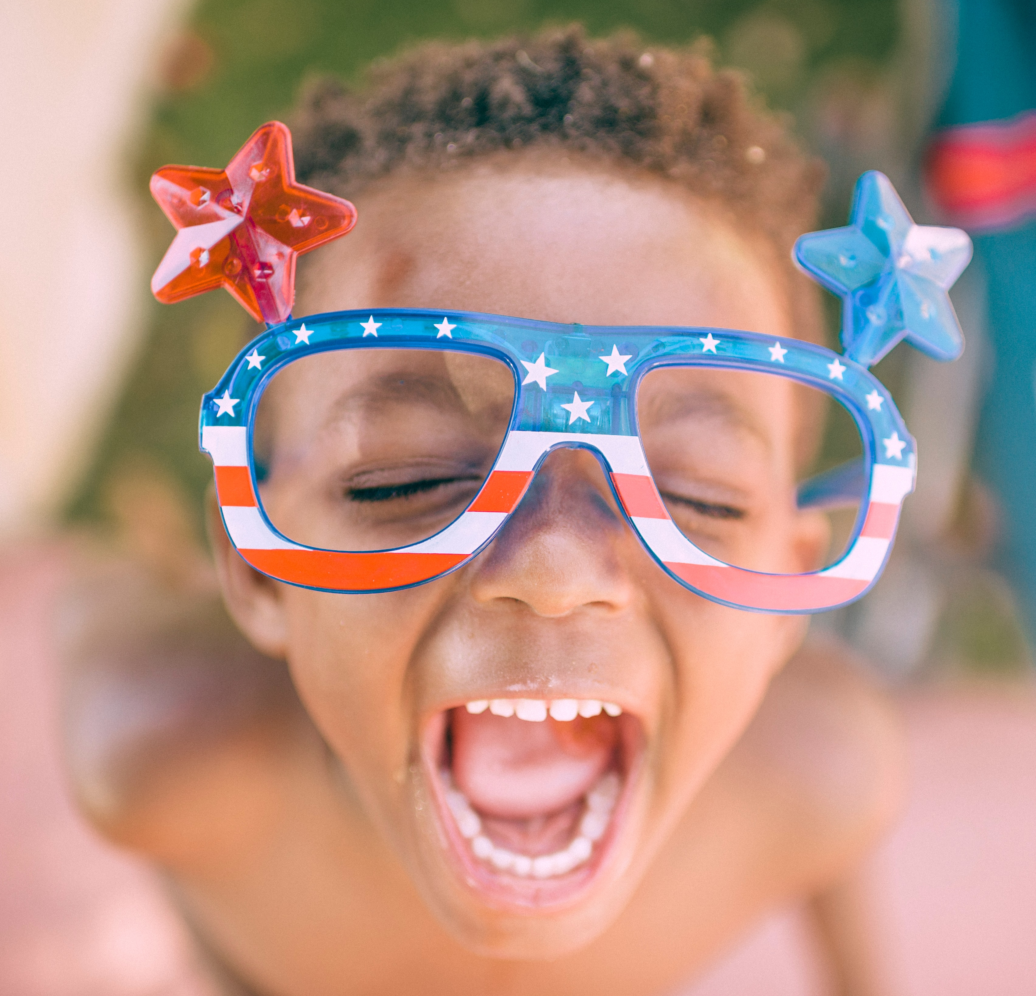
Study Overview
The Multicultural Multiplier: Cultural Diversity’s Impact on Travel Intent

Slide 16



Special thanks to the study’s founding sponsors:

Slide 17
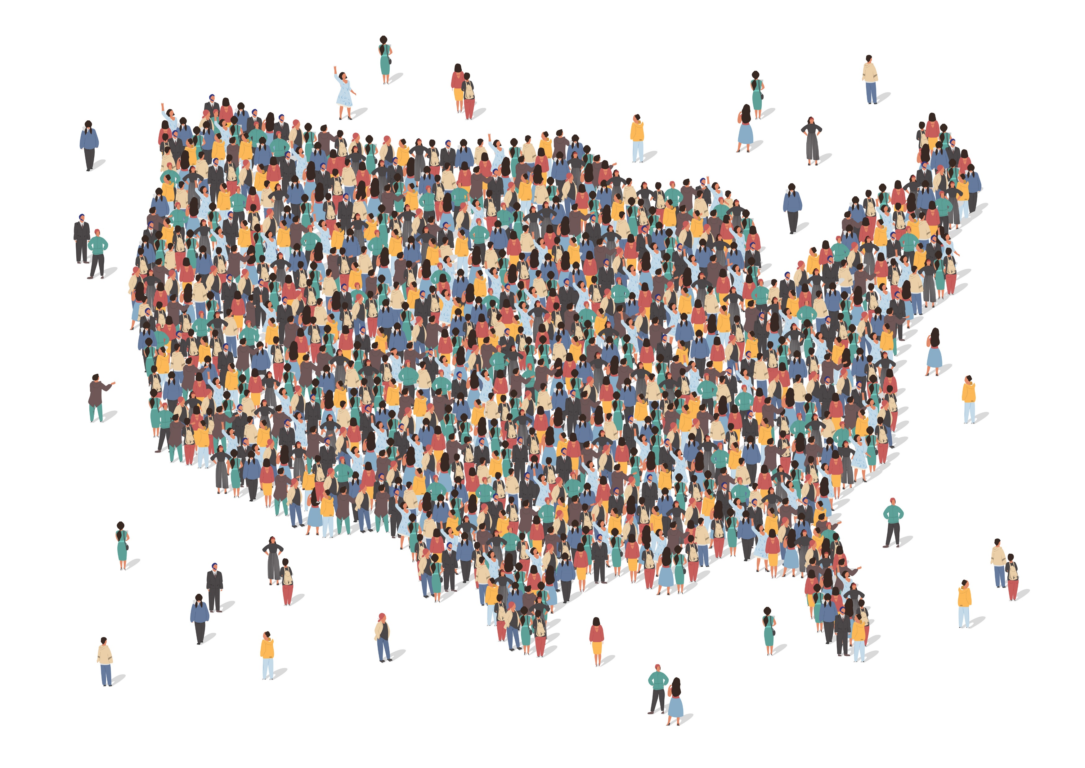
Diversity is the hallmark of American culture

Slide 18

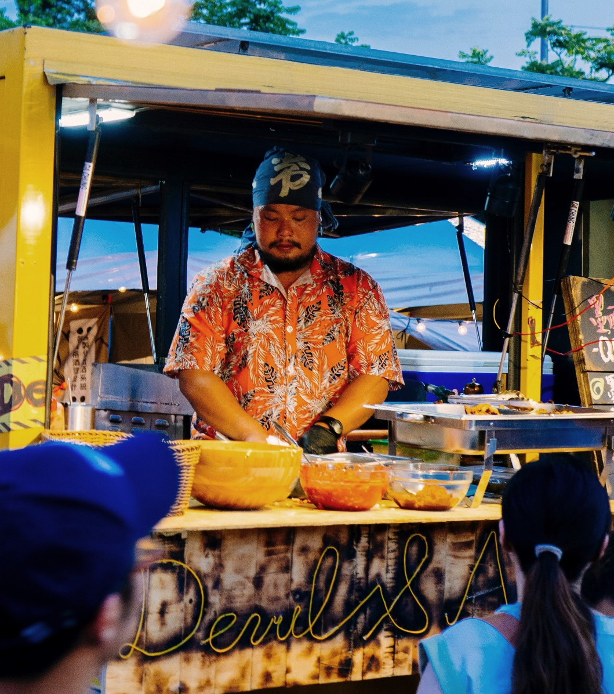
Support success of small, often minority-owned businesses
Enrich the traveler experience

Slide 19
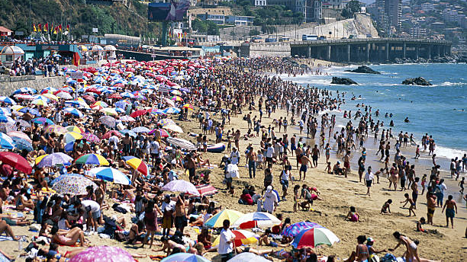
Help disperse overcrowding

Slide 20

How does showcasing cultural diversity impact consumer behavior?

Slide 21

Study Objectives
Quantify the impact that cultural diversity has on travel intent
  What perceptions or behaviors are impacted, and by how much?
Uncover insights to enhance marketing effectiveness for culturally diverse experiences (answers to who, what, when, where and why?)
Understand the current interest level for your destination among cultural travelers
Define profile(s) of culturally curious travelers and discover opportunities to better appeal to those your destination is not yet capturing
Identify potential perception challenges and pitfalls to avoid

Slide 22

Benefits
Data-driven recommendations on how to translate a desire to support diversity and small businesses into effective marketing execution
An in-depth look at culture-seeking traveler profiles (demographics, behaviors, preferences) and the ability to home in on specific groups within (e.g. people who are not yet considering your destination)
Tactical implications for creative and media
Leadership and support of the overarching effort to incorporate diversity in marketing

Slide 23

Methodology
Consumer survey of adult international leisure travelers (who plan their trips)
US – 2,000 (no international requirement)
CA – 1,000
MX – 1,000
UK – 1,000
CN – 1,000

Slide 24

The future will not be led by those who seek to recreate the past.
Social principles are now strategic imperatives.
Free from the confines of business as usual, use this opportunity to redefine success.

Slide 25

www.iolitegroup.com
Contact us:
clientservices@iolitegroup.com

Slide 26
Thank you!
STRATEGY RESEARCH IMPACT
Bridging data to action

