Slide 1
Telling Your Story in China

Slide 2
Agenda
Welcome
Karyn Gruenberg
Visa Entry
Aaron Wodin-Schwartz
How the Chinese Shop for Travel
Carroll Rheem
First Steps – Market Entry Program
Devon Dow
Importance of the Digital Media and Key Channels
Andrew Collins
Coming Soon
Karyn Gruenberg

Slide 3
Brand USA in China
Representation in Greater China for nearly 2 years
Beijing, Shanghai, Guangzhou, Taipei/Hong Kong
GoUSA.cn and GoUSA.tw
Tradeshows: CITM 2014, Brand USA awarded Country of Honor
Culinary Program: July 2014 trip with Chef Rick Bayless
China-U.S. Leadership Summit (Xiamen 2014; 2015 TBD)
Brand USA Sales Mission in China 2015 (March)
Roadshows in 2nd tier cities to educate the travel trade
New Market Entry Program
$46M in media exposure to date in 2014

Slide 4
China Marketing Initiatives
Brand USA has executed a number of successful consumer marketing initiatives in China:
Multi-Channel print, digital, and television inspirational marketing
In-Language Videos
Partner programs on GoUSA.cn and GoUSA.tw
Social media programs
Content Distribution and Development across all the major digital media channels in China
Notes:
First China multi-channel campaign (Fall 2014) supported by 10 partners Spring 2015 program already has 16 committed partners
150+ minutes of video content in-language with a China film crew; aired across 30 TV stations across China with total est. viewership of 210 Million
Custom micros site; 15+ Million page views; 5.8 Million UNIQUE Visits
OOH Clips from TV footage aired in 6 cities on metro LCD screens over a 6 week period
Video content appeared on key China digital channels - Youku & Tudou – 36 pieces of different content on the US
e-version of the supplement – e-version received over 1.2 million total page views in 90 days measured
Next one Spring 2015

Slide 5

China Multi-Channel Campaign
First China multi-channel campaign (Fall 2014 in market Sept/Oct)
150+ minutes of video content created in-language; aired across 30 TV stations across China
Estimated viewership of 210 million
Custom microsite supported the campaign
15+ million page views
5.8 million UNIQUE visits – better than average bounce rate compared to most DMO sites (44.4%)
OOH Clips from TV footage aired in 6 cities on metro LCD screens over a 6 week period
Video content appeared on key China digital channels - Youku & Tudou – 36 pieces of different content on the U.S.
E-version of print guide received over 1.2 million total impressions
Spring 2015 now available at http://marketing.milespartnership.com/thebrandusa/pdfs/15_BrandUSA_SellSheet_MultiChannel_china_1209L.pdf

Slide 6
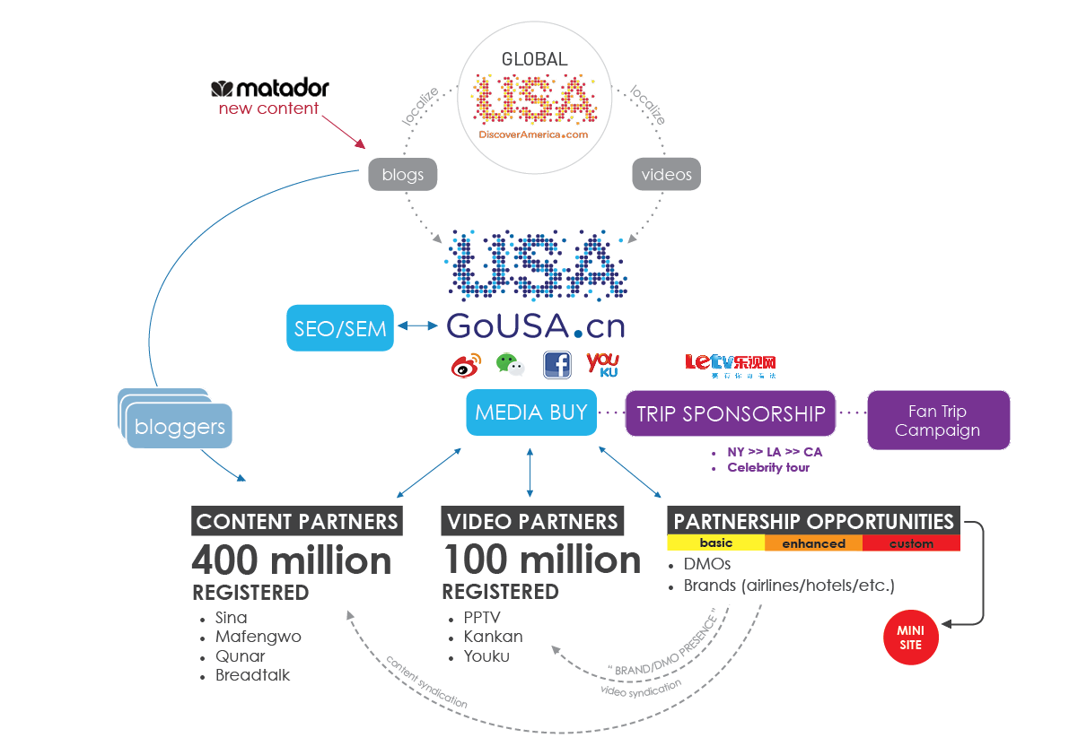
2015 Outlook
Notes:
500,000 M page views

Slide 7
Market the Welcome in China
Brand USA has moved quickly and aggressively to communicate the reciprocal extension of visa validity periods between the United States and China.
As a result of the 10-year visa validity announcement, Brand USA is expanding and accelerating a number of its partner programs in China, including an expansion of digital content and in-language assets.
The China visa update is the latest example of Brand USA working closely with Federal partners to communicate information about visa and entry policy directly to international travelers.

Slide 8
The Facts- How the Chinese Visitor Shops for Travel

Slide 9
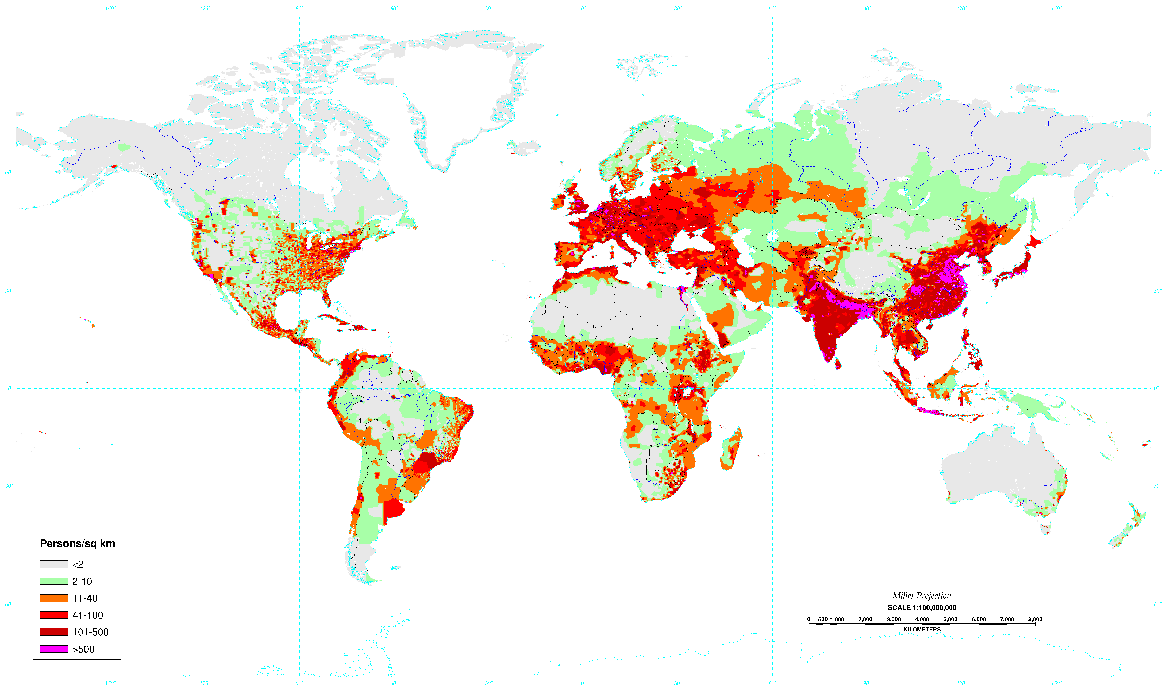
China Market Profile

Slide 10
US Arrivals and Long Haul Market Share 2012-2013
 | Market | 2012 | 2013 | 2013 arrivals (000) | 2013 US LH Share | YOY Share Variance
#1 | Canada | 6% | 3% | 23,387 | 66%* | 0.1%
 | CA Arrivals by air |  | 0.89% | 6,598
#2 | Mexico | 8% | 1%,-1% | 14,433 | 85%* | -0.2%
 | MX Arrivals by air |  | 0.44% | 3,098
#3 | United Kingdom | 0% | 0% | 3,835 | 22% | 0.0%
#4 | Japan | 14% | 1% | 3,730 | 38% | 0.0%
#5 | Brazil | 19% | 15% | 2,060 | 29% | 1.0%
#6 | Germany | 3% | 2% | 1,916 | 19% | 0.9%
#7 | China | 35% | 23% | 1,807 | 15% | 0.4%
#8 | France | -3% | 3% | 1,505 | 11% | -0.2%
#9 | Korea, Republic Of | 9% | 9% | 1,360 | 33% | 0.5%
#10 | Australia | 8% | 7% | 1,205 | 13% | 0.2%
#11 | India | 9% | 19% | 859 | 14% | 2.6%
#12 | Italy | -7% | 1% | 839 | 17% | 0.7%
#13 | Venezuela | 20% | 17% | 788 | 44% | 6.7%
#14 | Colombia | 21% | 24% | 748 | 45% | 4.1%
#15 | Argentina | 20% | 12% | 686 | 29% | 0.8%
#16 | Spain | -13% | 2% | 620 | 17% | 0.7%
#17 | Netherlands | -2% | 0% | 589 | 16% | -0.1%
#18 | Sweden | 1% | 8% | 477 | 22% | 1.2%
#19 | Switzerland | 0% | -1% | 473 | 20% | -0.5%
#20 | Ireland | -4% | 11% | 367 | 39% | 3.7%
#26 | Russian Federation | 17% | 36% | 353 | 4% | 0.8%
#32 | Chile | 9% | 28% | 241 | 27% | 2.7%
*Includes all international travel versus just long haul

Slide 11
Market Share of All China Outbound Travel U.S. vs. Competitors 2000-2024

Slide 12
Market Share of Long Haul China Outbound Travel U.S. vs. Competitors 2000-2024

Slide 13
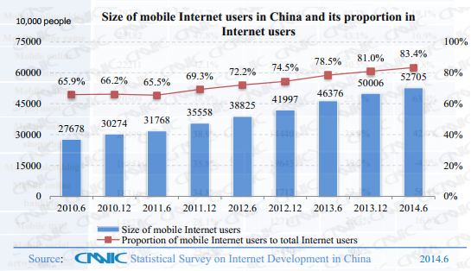
Mobile Internet Usage

Slide 14
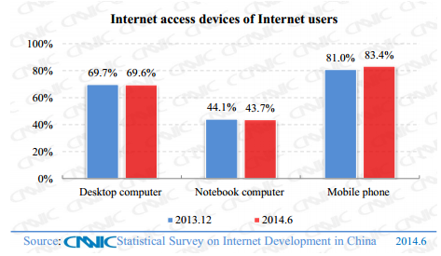
Devices Used to Access the Internet

Slide 15
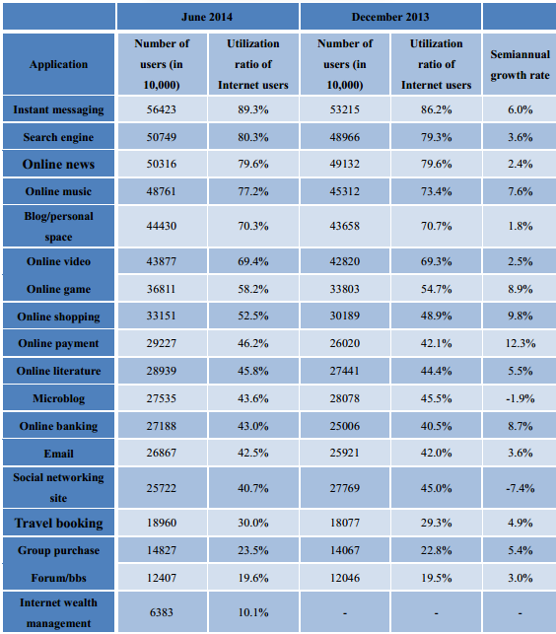
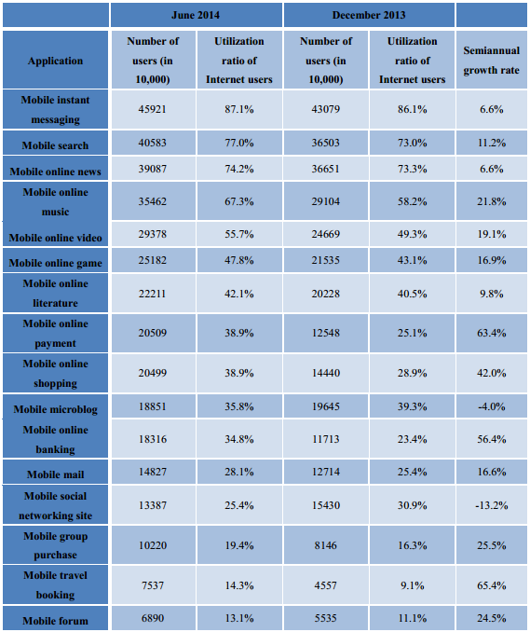
Chinese Online Application Usage
Source: CNNIC

Slide 16









China’s Top General Websites
Sohu | Tencent | Baidu | Qihoo | Alibaba | Youku | SINA | NetEase | IQIYI | LETV
Portal | Portal | Search | Internet Security | Retail | Video | Portal | Portal | Video | Video
NASDAQ: SOHU | HKG: Tencent Hldg | NASDAQ: BIDU | NYSE: QIHU | NYSE: BABA | NYSE: YOKU | NASDAQ: SINA | NASDAQ: NTES | Private | Shanghai: 300104

Slide 17










China’s Top Travel Websites
Ctrip | Qunar | 12306 | Trip Advisor | LVMAMA | Expedia | 17u | TUNIU | 360.cn | Mango city
OTA | OTA | Rail | Information | OTA | OTA | OTA | OTA | Information | OTA
NASDAQ: CTRP | Nasdaq: QUNR | Govern-ment | NASDAQ: TRIP | Private | NASDAQ: EXPE | Private | NASDAQ: TOUR | NYSE: QIHU | Private
2.2 M

Slide 18
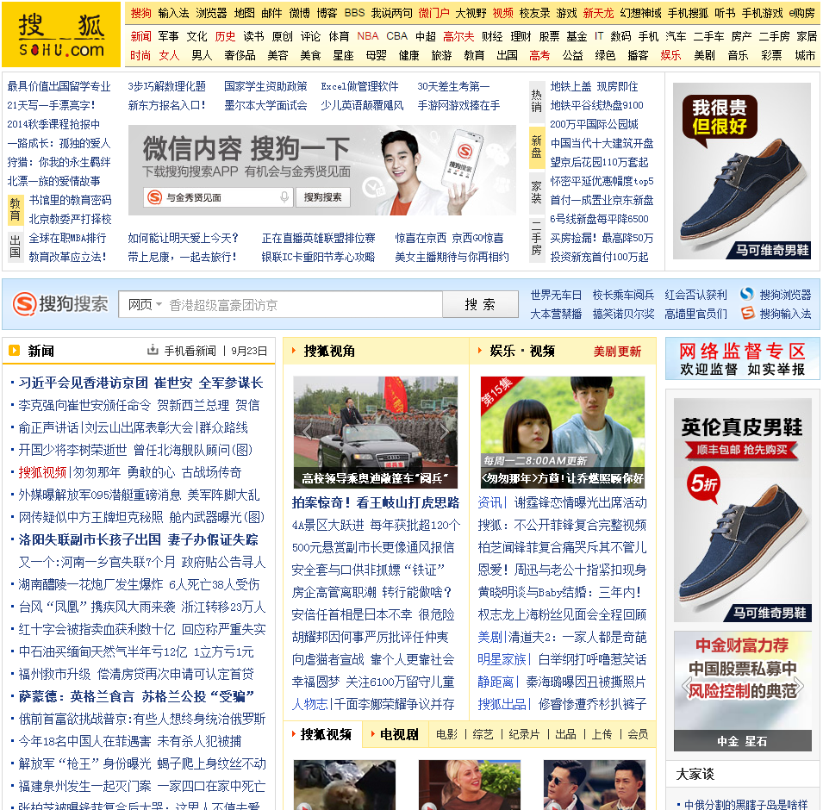
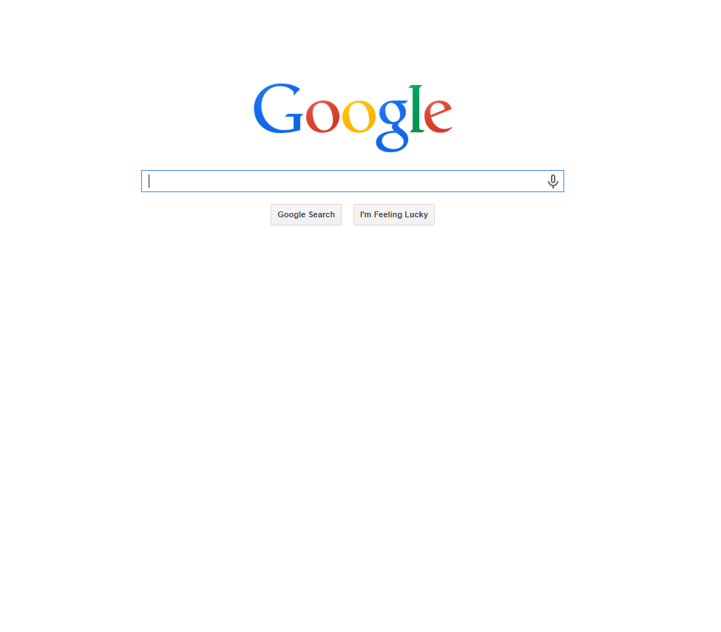
Digital Context – Top Sites
Searching vs. Browsing

Slide 19
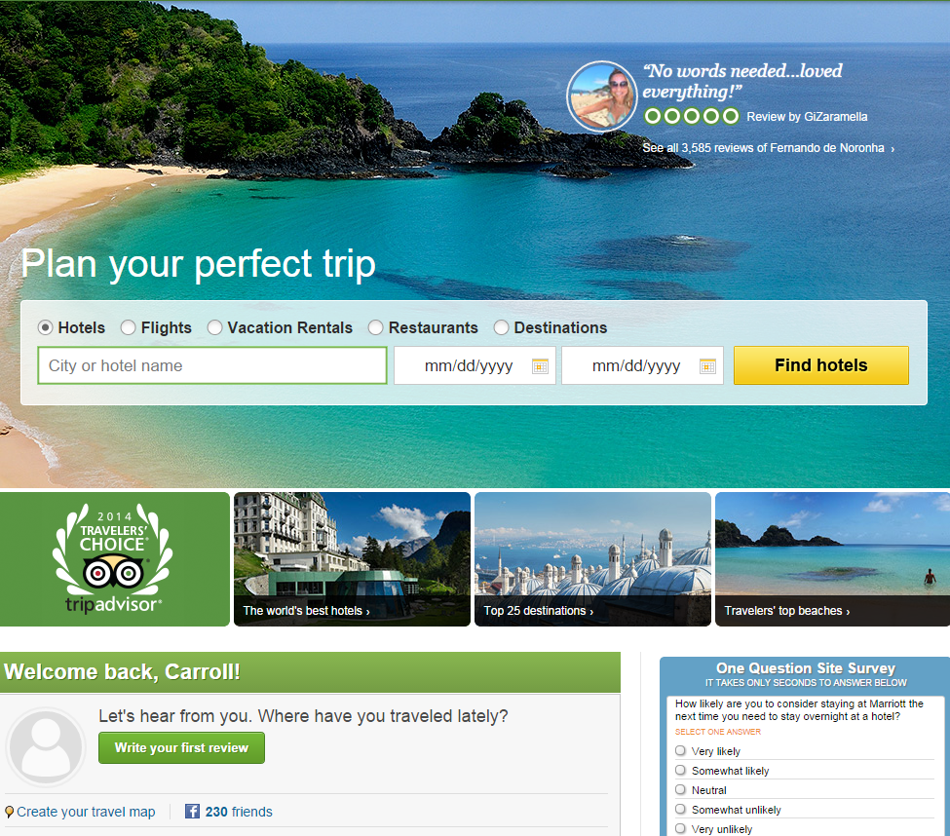
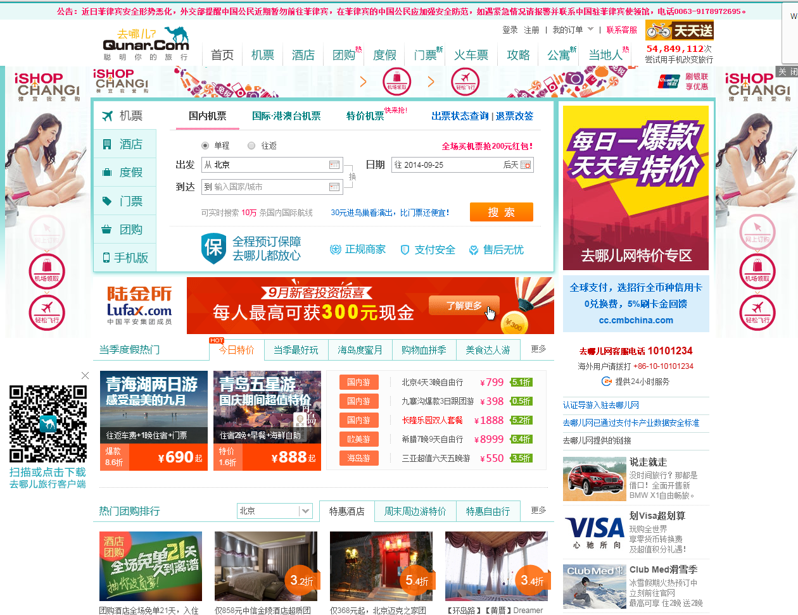
Digital Context – Travel Information Sites

Slide 20
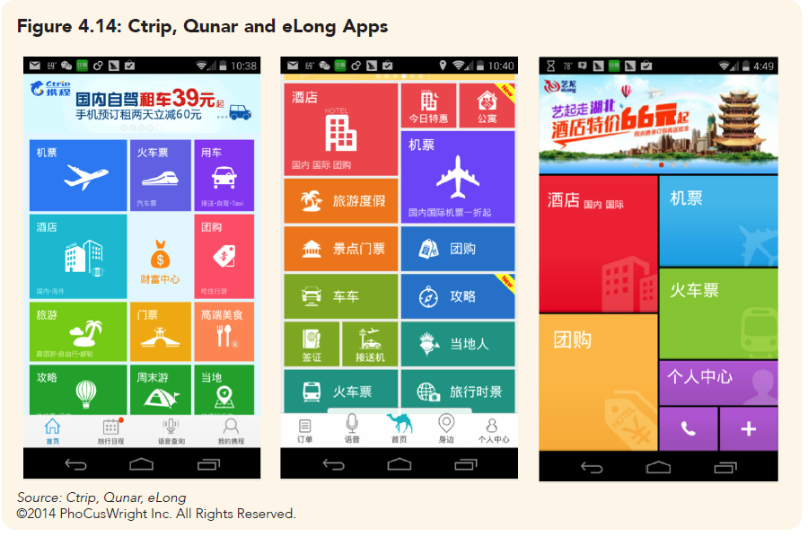
Ctrip, Qunar, eLong Mobile Apps

Slide 21
Entering the Market

Slide 22
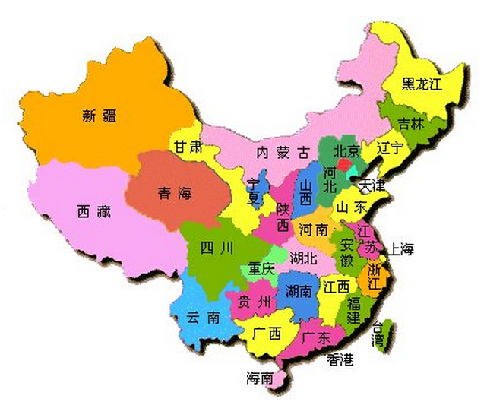
China Market Entry Program
Suite of promotional activities designed to maximize the promotional opportunities in this rapidly emerging market
Includes dedicated resources for
Initial Consultation
Travel Trade Development
Public Relations
Sales Calls
Participation in Events, Missions, etc.
Trade / Media Coop Opportunities
Media Coop Opportunities
GoUSA.cn participation
Digital / Social Channel Campaigns
USA Discovery Program – online training certification
Notes:
As I mentioned, the Great Outdoors and Urban Excitement/Culinary are the key themes here:
Production launched this month on the giant screen film—and we’ll be promoting that production through a content hub that offers many opportunities for partner integration.
We will also promote the Great Outdoors through our core consumer and trade advertising efforts---and adding a new component of marketing merchandise that is uniquely American---made in the USA products. As examples, a few brands in our consideration set are:
Ralph Lauren (outerwear)
Nike (shoes and clothing)
Pendleton (park blanket)
We are in the initial stages of this concept—so more to come on that in FY15
When the film opens next year, we will be promoting it in a big way through a number of film premier events, public relations activities, and the like—again, with as much partner integration as possible.
We are also developing a number of media spin offs to further market the great outdoors---one in particular is a 10-part TV series with Travel Channel.

Slide 23
So How Do They Learn About You?

Slide 24


They Use Different Social Networks
WeChat is China’s fastest growing social network. Primarily an instant messaging and voice multimedia service, it has a user base of over 430 million monthly active users. It is fast becoming the most personal way for brands to connect with a very mobile consumer.
Weibo, ‘China’s Twitter’ is the biggest social network in China. With over 150 million monthly active users, it is the primary platform for users to connect with celebrities and brands, it also has the highest engagement amongst trendsetters.

Slide 25



They Read Different Blogs
China’s largest online media portal serving China and the global Chinese communities. Sina operates four major business lines: Sina Weibo, Sina Mobile, Sina Online, and Sina.net. Sina has over 100 million registered users worldwide.
Qunar is the leading travel search engine in China, Qunar aims to provide Chinese travelers with most comprehensive and accurate travel information, and bring China’s travel industry online and mobile.
Mafengwo is a travel website featuring some of the best itineraries and travel guides across different destinations. Mafengwo builds communities to share and discover like-minded Chinese travelers

Slide 26



They Watch Videos Somewhere Else
Youku, ‘China’s YouTube’, is the country’s #1 online video platform. With a focus on user uploaded content, it is also used by sports teams to post subtitled videos, highlights, etc. and sharing them further across other social channels.
PPTV is the largest leading online TV service in China offering featured television shows, sports, entertainment, news and travel content. It is characterized for its live-streaming service and professional video production.
Leading Internet video company in China providing premium licensed content, user generated content, and original in-house production. A truly on-demand and interactive viewing experience where users can find content they want to view, share content they create and interact with other users on Tudou’s platform.

Slide 27
China is Different
They like different things and different places for different reasons…
They love shopping in particular for high fashion luxury products and big outlets
They often travel in groups and aren’t deterred by crowded places
Generally not known to like outdoor activities but enjoy beautiful scenery
The older generation prefers big cities, while the younger generation is more open to exploring smaller, lesser known areas
Food is a major motivation for travel
Landmarks are still a big point for first time Chinese tourists to the U.S.

Slide 28
GoUSA Footprint in China

Slide 29
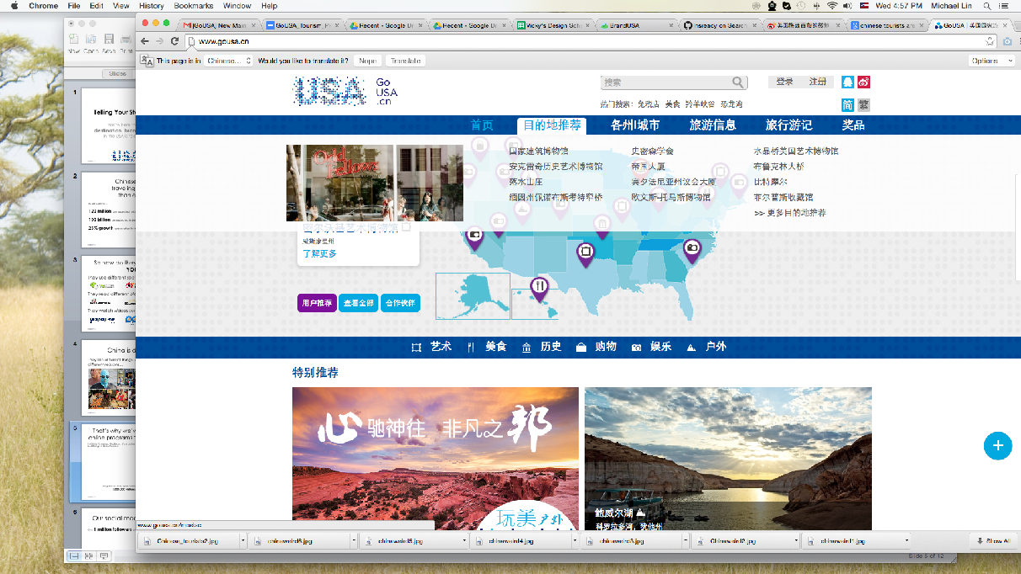
GoUSA – The Website
In China it’s named GoUSA.cn. It’s a platform which helps Chinese discover the best things to do in America.
Fast becoming the No.1 source of US related travel content in China
GoUSA.cn and GoUSA.tw are responsively designed and built by a Chinese agency specifically for Chinese audiences

Slide 30
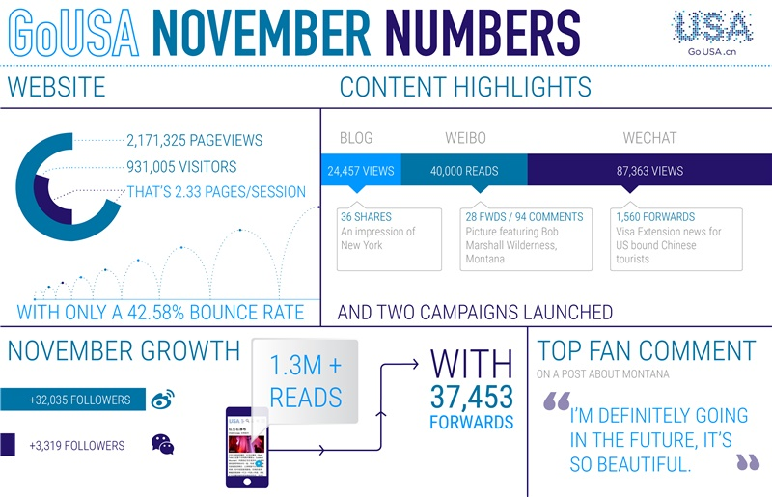

Slide 31
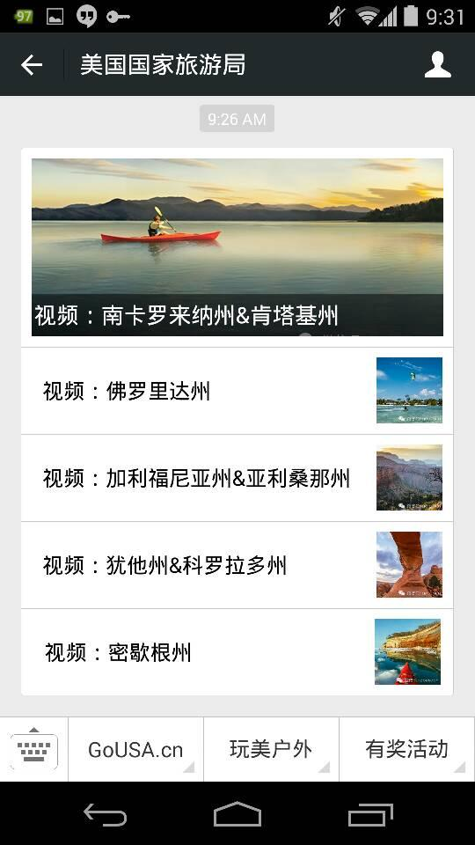
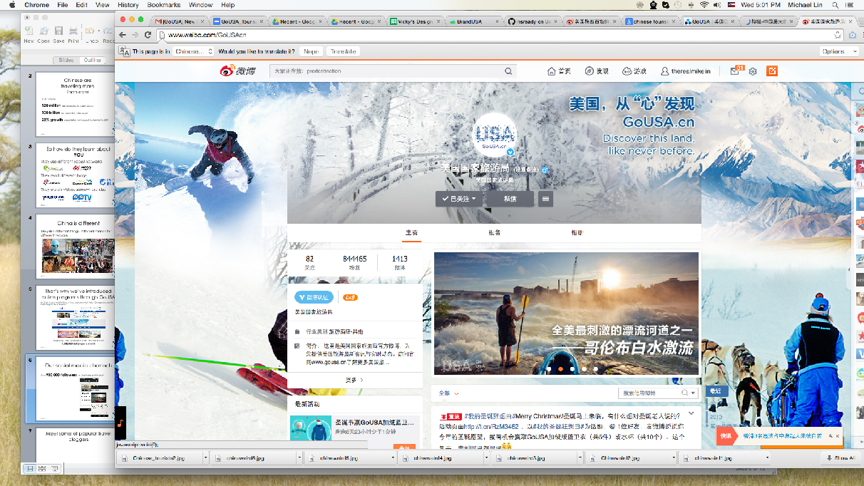
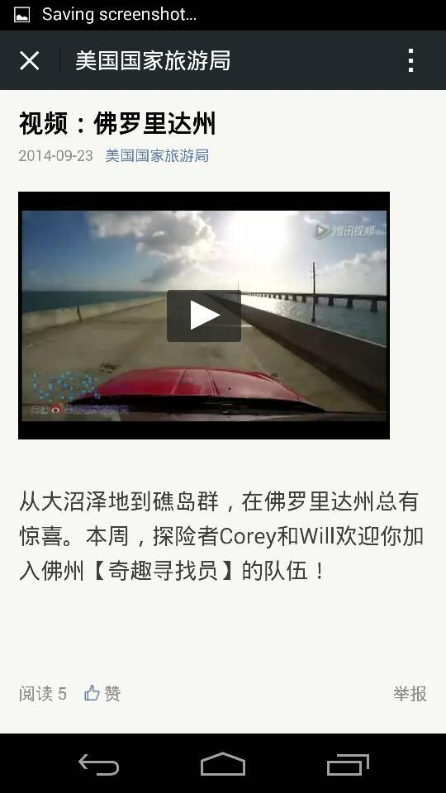
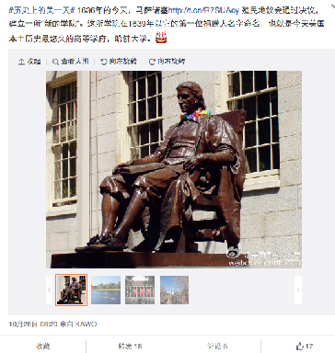
Our Social Media Channels
GoUSA Chinese social media footprint is 900,000+ across Sina Weibo and WeChat
10 posts+ per day across our channels
Featuring the best US travel guides, shopping experiences, outdoor adventures and city escapes

Slide 32





Popular Travel Bloggers
Our network of KOL (Opinion Leaders) are the most influential in China. In 2014 GoUSA received over 100,000,000 impressions through KOLS.
Did you know?
Over 90% of tourism decisions are influenced by KOLs in China.

Slide 33

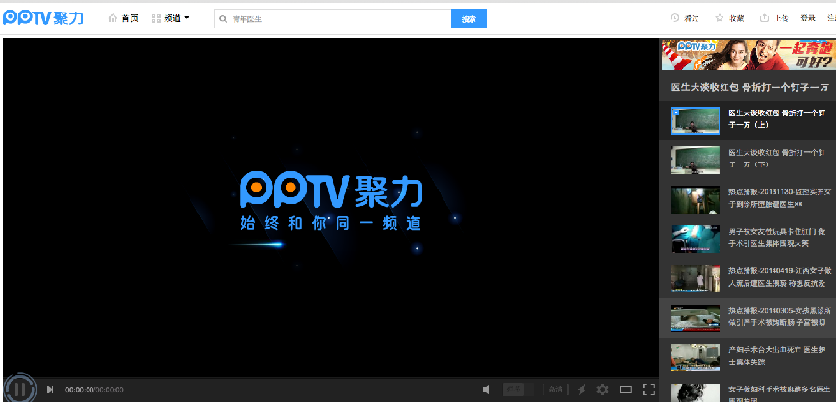

Syndicated Content
We produce 1000s of unique content pieces which are shared through dozens of media outlets across China.
We have exclusive content featured programs and ad rolls which run across China’s largest video portals.

Slide 34
Brand USA Digital Opportunities in China

Slide 35
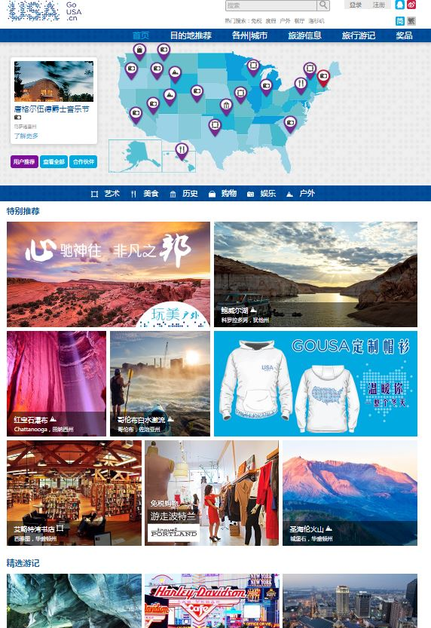
Campaign Page
We’re now offering ‘high value’ programs across all our channels which provide partners reach throughout China.
Campaign Site
Video and Photo Gallery
Custom URLs (.CN/.TW)
Up to 10 activity listings
1 month featured tiled promo
2 posts per a month for 3 months on GoUSA social channels
Up to 2 featured blogs on GoUSA
Quarterly reporting

Slide 36
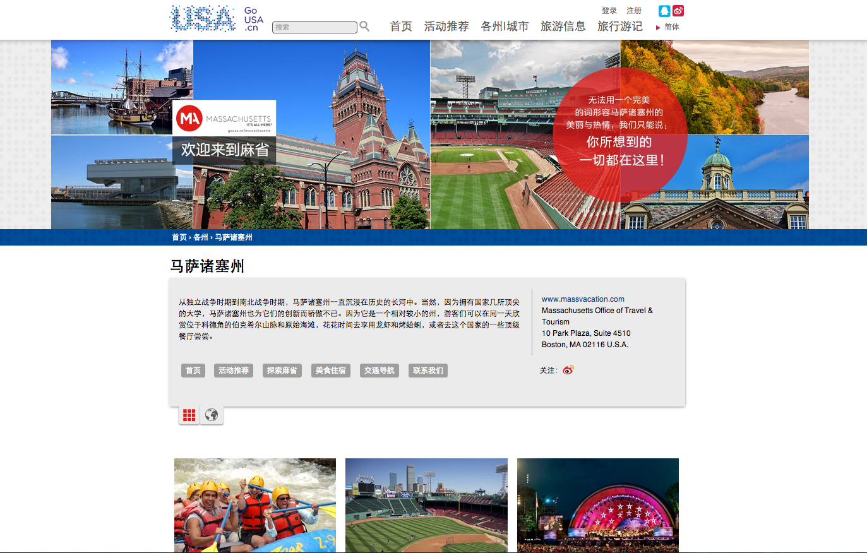
Custom Sites
Create full content pages and gain a real impact in China.
The Custom Site: Making an Impact
Up to 50 activity listings
3 month featured tiled promo
5 posts per a month for 6 months on GoUSA social channels
Up to 2 featured blogs per a month over 3 months
Localized banner design
China social links
Promoting the Custom Site
Syndicate up to 5 content pieces with China’s leading travel content websites
Be featured in strategic media placement across key partners
*Custom site includes all features in campaign package

Slide 37
Get Social
Brand USA will extend its reach targeting your destination
Full Service: Make that Presence Felt
Full Campaign Management
Account Support
Social Media Strategy Planning and Custom Content Creation
Monthly Strategy Reporting
5 Key Opinion Leaders per Month

Slide 38
Learn How Massachusetts Let Us Tell Their Story

Slide 39
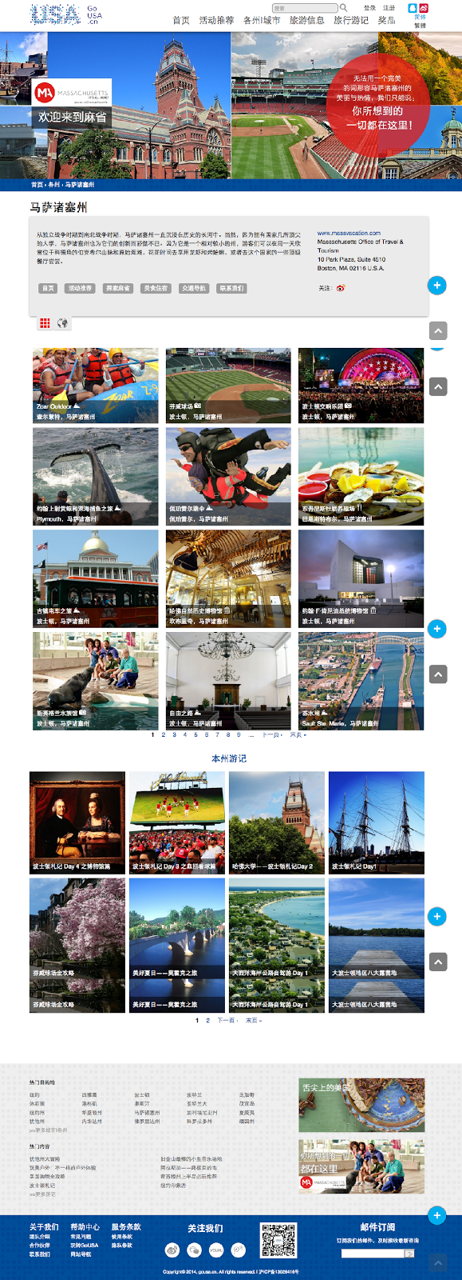
Custom Site: Massachusetts
2.1 MILLION
SITE VISITORS:
OVER 2m
PAGEVIEWS
138
ACTIVITIES LISTED
(ADDED OVER 80 WITH LAUNCH)
EACH ACTIVITY AVERAGED
25 SHARES TO WEIBO
15 PIECES
WE CREATED
OF UNIQUE CONTENT

Slide 40
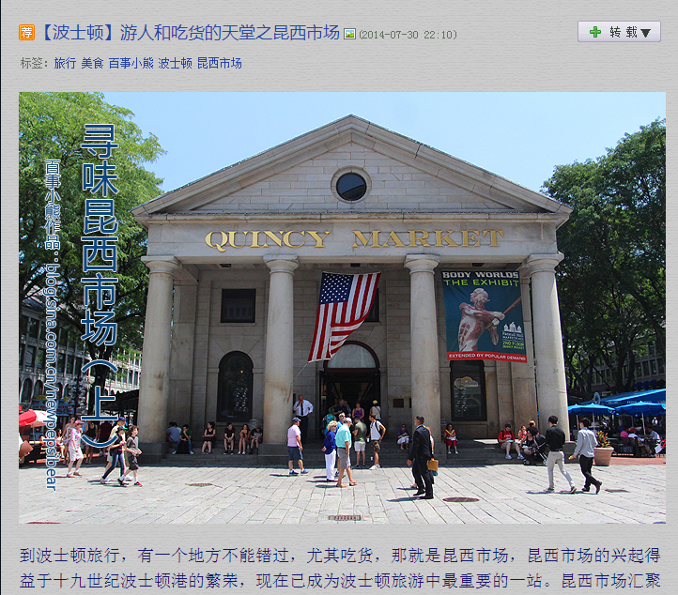
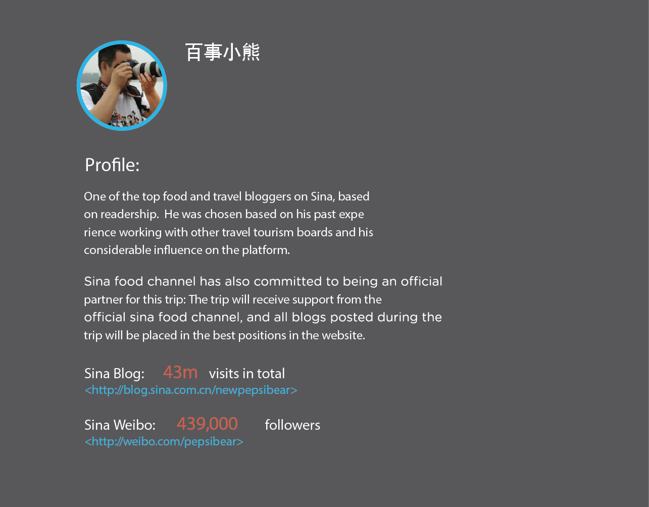
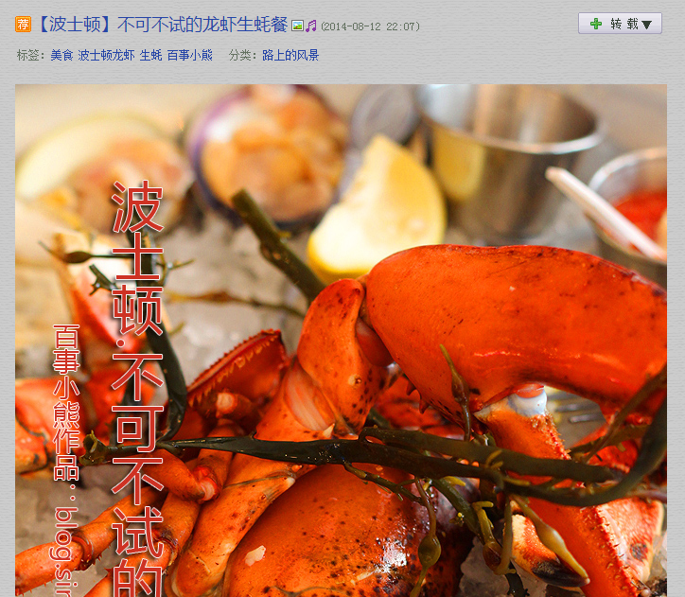
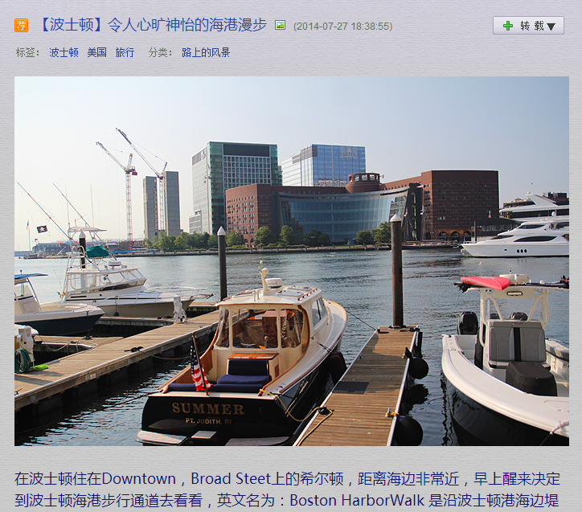
Top Blogger Travels to Massachusetts
9 Blogs written on Sina
674,654 Total Reads

Slide 41
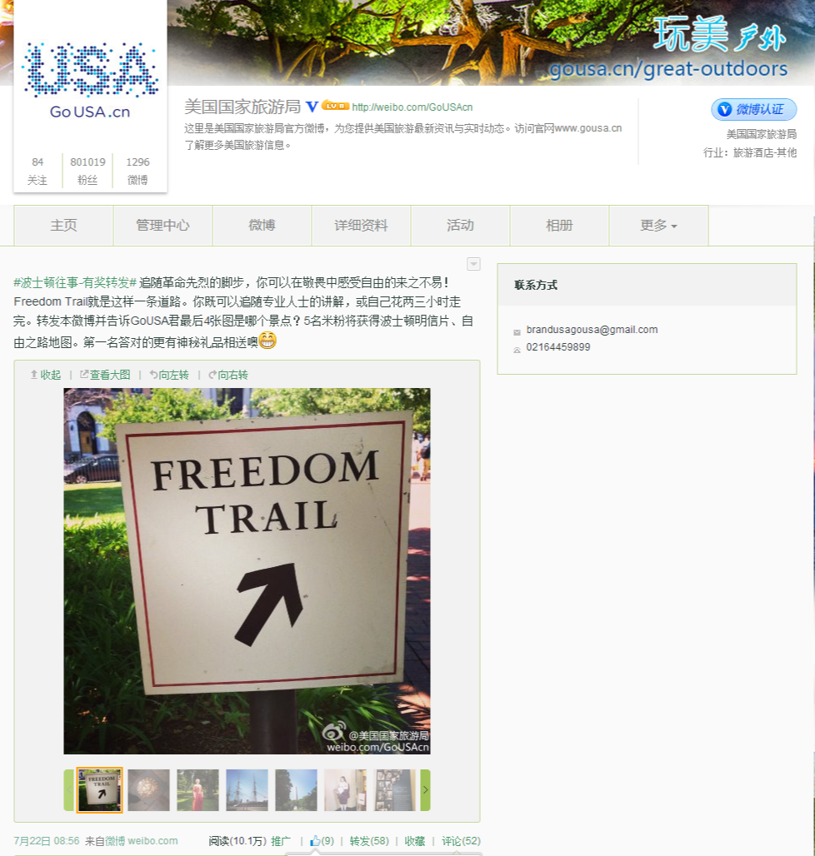
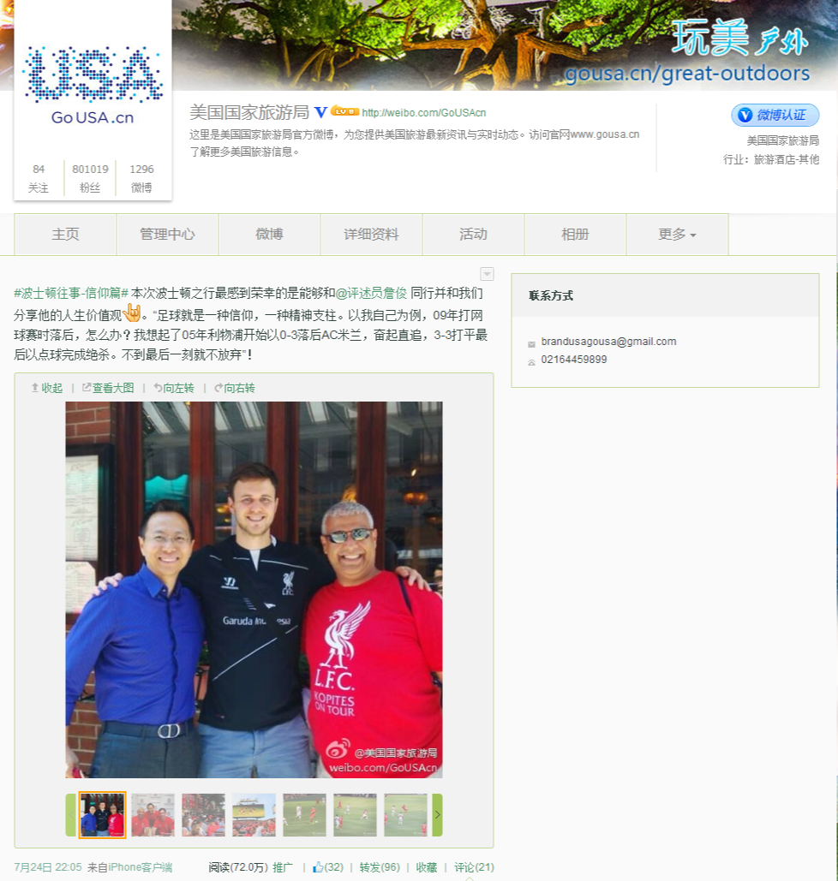
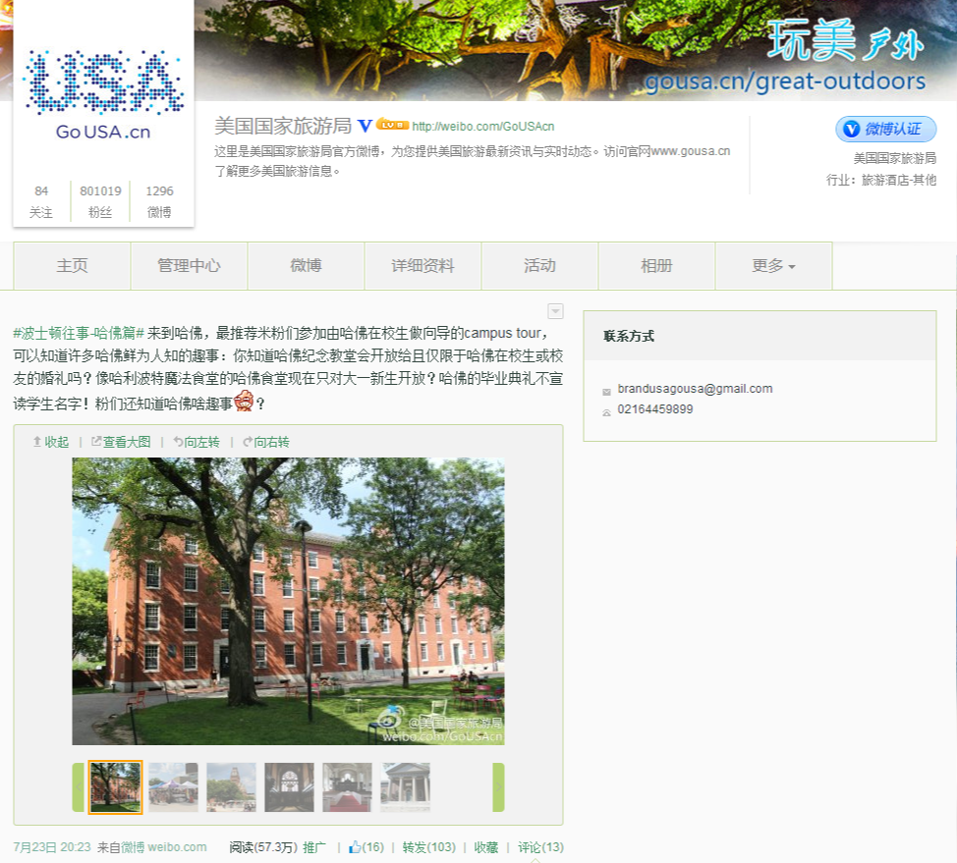
Most Engaged Massachusetts Content
24 JULY: 720,000 READS
32 LIKES, 96 REPOSTS
23 JULY: 573,000 READS
16 LIKES, 106 REPOSTS
22 JULY: 101,000 READS
9 LIKES, 58 REPOSTS

Slide 42
Digital & Social Growth Has Been… Explosive in China
Use of traditional broadcast and print media in China is expensive. Fortunately, digital and social are affordable and impactful – especially when we distribute real content as opposed to advertising messages.

Slide 43






Overview By The Numbers
Estimated Outreach:
300 million registered users
on selected partnership sites
Total Impact Across Sites:
500 million views
on GoUSA.cn content and media

Slide 44
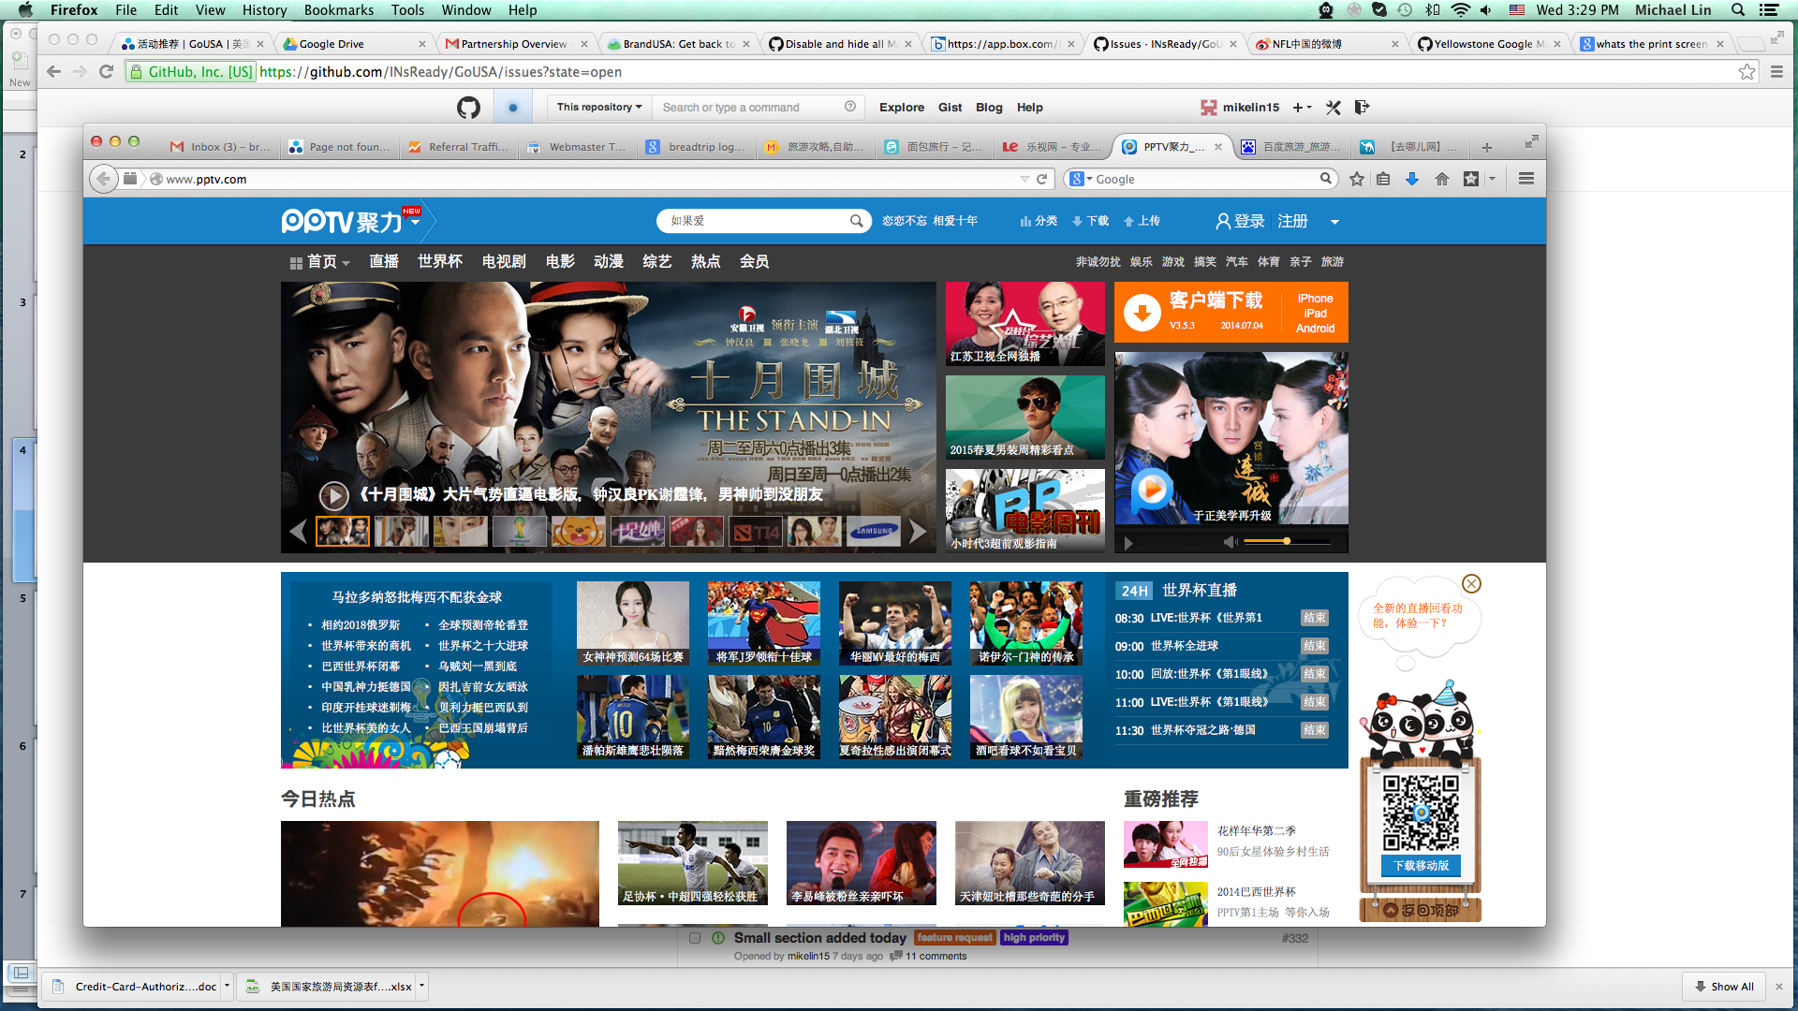
PPTV
Online television has grown exponentially in China with PPTV broadcasting shows, sports, news and entertainment. Messaging is included as part of content, rather than as advertising.
On-demand video complements search and is often shared with friends & family. Tudou commands the largest share of audience in China.
Tudou

Slide 45
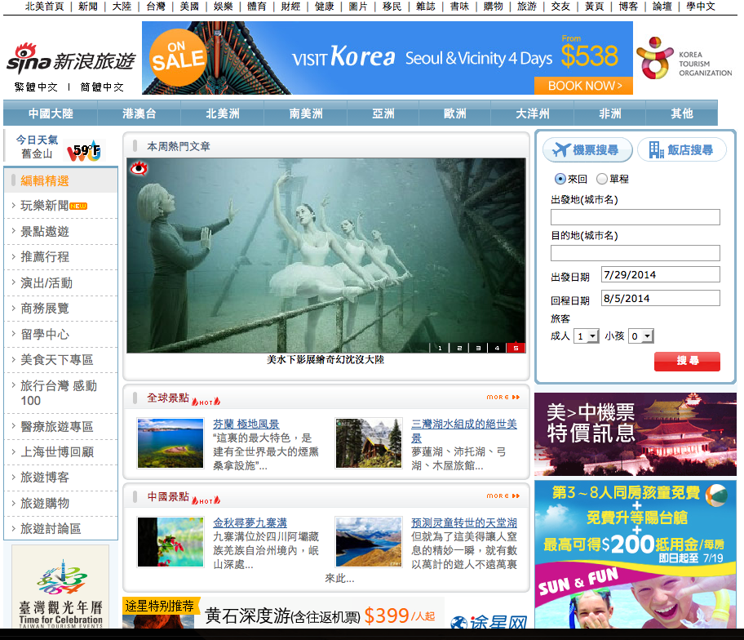
Sina
As China’s largest social voice, Sina is a vital media property for reaching engaged consumers. Sina has over 100 million registered users and operates outlets that function like Facebook and Twitter.
Appearing in search results drives action. Travel deals and comprehensive travel info have established Qunar as the go to OTA for Travel search in China.
Qunar

Slide 46

Creating a Video Series on Tudou
Video Series
GoUSA China video series (Urban Finds, City Escapes)
Editing, localization and promotion included
Media
Promotion of the video series on Tudou
Each video will feature partner content
Options to create more in-video promotional partners

Slide 47



Packages with for Partner Content and Distribution
10 activity listings
3 long stories
4 social media postings
Featured video
Media supported
7.2M impressions
20 activity listings
8 pieces of long content
10 social media postings
Featured video
Monthly blogs
17M impressions
Notes:
#1 $216,000 Value #2
Co-branded advertising
Blog features
3 pages of guidebook

Slide 48
For Information on All of Our China Programs Contact:
Your Brand USA Partner Development Representative
Sarah Dickson
Sdickson@thebrandusa.com
Philip Joseph
Pjoseph@thebrandusa.com
Dianne Turner
Dturner@thebrandusa.com
Your Representative at Miles
Paul Winkle
Paul.Winkle@MilesPartnership.com
John DeLeva
John.Deleva@MilesPartnership.com
Debi Saldana
Debi.Saldana@MilesPartnership.com
Angie Zok
Angie.Zok@MilesPartnership.com

Slide 49
Thank You!
Details about future Brand USA webinars coming soon.
GoUSA.cn / GoUSA.tw
DiscoverAmerica.com
@DiscoverAmerica
Facebook.com/DiscoverAmerica
YouTube/DiscoverAmerica
Instagram: DiscoverAmerica
Google.com/+DiscoverAmerica

